Slide 1
CECS 326 Operating Systems
Deadlocks
(Chapter 7, Operating system Concepts by Silberschatz, Galvin and Gagne)

Slide 2
System Model
System consists of resources
Resource types R₁, R₂, . . ., R_{m}
CPU cycles, memory space, I/O devices
Each resource type R_{i} has W_{i} instances
Each process utilizes a resource as follows:
Request
Use
Release
Request and release of resources may be made by system calls, such as request() & release() device, open() & close() file, allocate() & free() memory
A set of processes is in a deadlocked state when every process in the set is waiting for an event that can be caused only by another process in the set

Slide 3
Example of a Deadlock
Two files F₁ and F₂, requires mutually exclusive access
Semaphore solution to enforce mutual exclusion
Semaphore mutex1 initialized to 1, for F₁
Semaphore mutex2 initialized to 1, for F₂
Two processes, both need to use F₁ and F₂ as follows. Deadlock may result
Process 1: Process 2:
. . . . . .
wait(mutex1); wait(mutex2);
wait(mutex2); wait(mutex1);
Use F₁ and F₂ Use F₁ and F₂
signal(mutex2); signal(mutex1);
signal(mutex1); signal(mutex2);
. . . . . .

Slide 4
Deadlock Example
void transaction(Account from, Account to, double amount) {
mutex lock1, lock2;
lock1 = get_lock(from);
lock2 = get_lock(to);
acquire(lock1);
acquire(lock2);
withdraw(from, amount);
deposit(to, amount);
release(lock2);
release(lock1);
}
Transactions 1 & 2 execute concurrently. Transaction 1 transfers $25 from account A to account B, and Transaction 2 transfers $50 from account B to account A
Can deadlock occur?

Slide 5
Deadlock Characterization
Deadlock can arise if 4 conditions hold simultaneously
Mutual exclusion – only one process at a time can use a resource
Hold and wait – a process holding at least one resource is waiting to acquire additional resources held by other processes
No preemption – a resource can be released only voluntarily by the process holding it, after that process has completed its task
Circular wait – there exists a set of waiting processes {P₀, P₁, …, P_{n}} such that P₀ is waiting for a resource that is held by P₁, P₁ is waiting for a resource that is held by P₂, …, P_{n–1} is waiting for a resource that is held by P_{n}, and P_{n} is waiting for a resource that is held by P₀.

Slide 6
Resource Allocation Graph
A set of vertices V and a set of edges E
V is partitioned into two types:
P = {P₁, P₂, …, P_{n}}, the set consisting of all the processes in the system
R = {R₁, R₂, …, R_{m}}, the set consisting of all resource types in the system
request edge – directed edge P_{i} → R_{j}
assignment edge – directed edge R_{j} → P_{i}

Slide 7
Resource Allocation Graph
Process
Resource Type with 4 instances
P_{i} requests instance of R_{j}
R_{j}
P_{i} is holding an instance of R_{j}
R_{j}
P_{i}
P_{i}

Slide 8
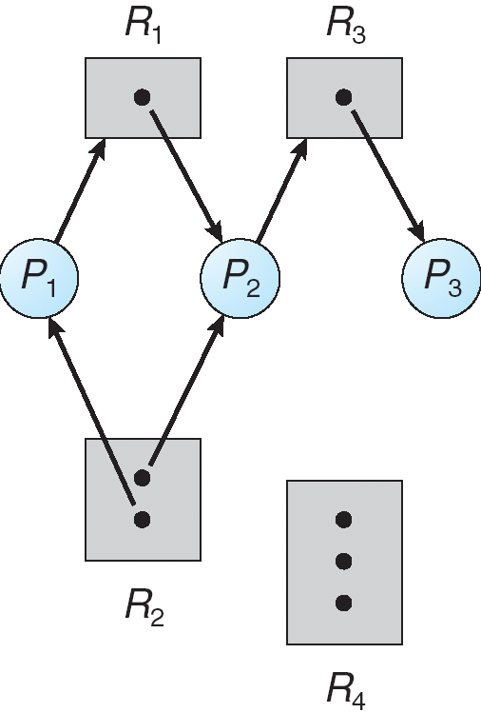
Example of Resource Allocation Graph

Slide 9
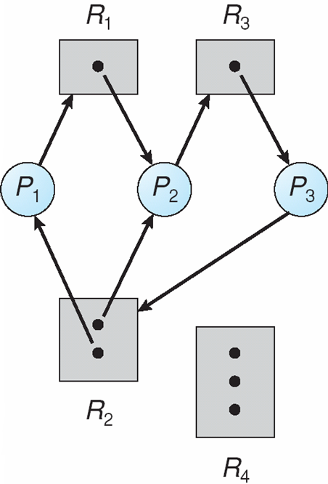
Resource Allocation Graph with a Deadlock

Slide 10
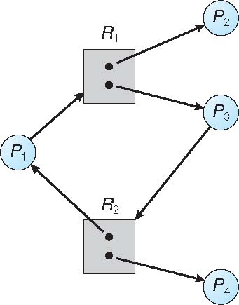
Graph with a Cycle But No Deadlock

Slide 11
Basic Facts
If graph contains no cycle ⇒
no deadlock
If graph contains a cycle ⇒
If only one instance per resource type, then deadlock
If several instances per resource type, possibility of deadlock

Slide 12
Methods for Handling Deadlocks
Ensure that the system will never enter a deadlock state
Deadlock prevention
Deadlock avoidance
Allow the system to enter a deadlock state, recover when deadlock Is detected
Ignore the problem and pretend that deadlocks never occur in the system; used by most operating systems. Including UNIX

Slide 13
Deadlock Prevention
Restrain the ways that resource request can be made so that one of the following conditions will not hold:
Mutual Exclusion – this is not required for sharable resources *e.g., read-only files), but must hold for non-sharable resources
Hold and Wait – guarantee that whenever a process requests a resource, it doesn’t hold any other resources
Require process to request and be allocated all its resources before it begins execution, or allow process to request resources only when the process has none allocated to it
Low resource utilization, and starvation possible
No Preemption –
A process holding some resources requests another resource that is not immediately available is required to release all that it is currently holding
Preempted resources are added to the list of resources for which the process is waiting
Process will be restarted only when it can regain its old resourcs as well as the new ones that it is requesting
Circular Wait – impose a total ordering of all resource types, and require that each process requests resources in an increasing order of enumeration

Slide 14
Deadlock Avoidance
Requires that the system has some additional a priori information available
Simplest and most useful model requires that each process declare the maximum number of resources of each type that it may need
The deadlock avoidance algorithm dynamically examines the resource allocation state to ensure that there can never be a circular wait condition
Resource allocation state is defined by the number of available and allocated resources, and the maximum demands of the processes

Slide 15
Deadlock Avoidance – Safe State
When a process requests an available resource, system must decide if the immediate allocation leaves the system in a safe state
System is in safe state if there exists a sequence <P₁, P₂, …, P_{n}> of all the processes in the system such that for each P_{i}, the resources that P_{i} can still request can be satisfied by currently available resources + resources held by all the P_{j}, with j < i. That is,
If P_{i} resource needs are not immediately available, then P_{i} can wait until all P_{j} have finished
When P_{j} is finished, P_{i} can obtain needed resources, execute, return allocated resources, and terminate
When P_{i} terminates, P_{i +1} can obtain its needed resources, and so on

Slide 16
Basic Facts
If a system is in safe state ⇒ no deadlocks
If a system is in unsafe state ⇒ possibility of deadlock
Avoidance ⇒ ensure that a system will never enter an unsafe state

Slide 17
Avoidance Algorithms
Single instance of a resource type
Use a resource-allocation graph
Multiple instances of a resource type
Use the banker’s algorithm

Slide 18
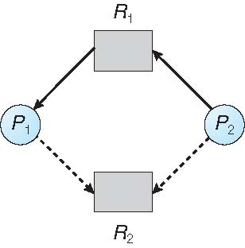
Resource-Allocation Graph Algorithm
Resources must be claimed a priori in the system
Claim edge P_{i} → R_{j} indicates that processes P_{j} may request resource R_{j}, represented by a dashed line in the graph
Claim edge converts to request edge when a process requests a resource

Slide 19
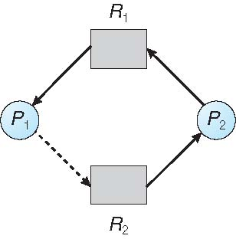
Resource-Allocation Graph Algorithm
Request edge converted to an assignment edge when the resource is allocated to the process
When a resource is released by a process, assignment edge reconverts to a claim edge
An unsafe state
A request can be granted only if converting the request edge to an assignment edge does not result in the formation of a cycle in the graph

Slide 20
Banker’s Algorithm
System model
Multiple instances in a resource type
Each process must a priori claim maximum use
When a process requests a resource it may have to wait
When a process gets all its resources it must return them in a finite amount of time

Slide 21
Data Structures for the Banker’s Algorithm
Let n = number of processes, and m = number of resources types
Available: Vector of length m. If Available [j] = k, there are k instances of resource type R_{j} available
Max: n x m matrix. If Max [i,j] = k, then process P_{i} may request at most k instances of resource type R_{j}
Allocation: n x m matrix. If Allocation[i,j] = k then P_{i} is currently allocated k instances of R_{j}
Need: n x m matrix. If Need[i,j] = k, then P_{i} may need k more instances of R_{j} to complete its task
Need [i,j] = Max[i,j] – Allocation [i,j]

Slide 22
Safety Checking
Let Work and Finish be vectors of length m and n, respectively. Initialize:
Work = Available
Finish [i] = false for i = 0, 1, …, n- 1
2. Find an i such that both:
(a) Finish [i] = false
(b) Need_{i} ≤ Work
If no such i exists, go to step 4
3. Work = Work + Allocation_{i} Finish[i] = true go to step 2
4. If Finish [i] == true for all i, then the system is in a safe state, else unsafe

Slide 23
Resource-Request for Process P_{i}
Request_{i} = request vector for process P_{i}. If Request_{i} [j] = k then process P_{i} wants k instances of resource type R_{j}
1.If Request_{i} ≤ Need_{i} go to step 2. Otherwise, raise error condition, since process has exceeded its maximum claim
2.If Request_{i} ≤ Available, go to step 3. Otherwise P_{i} must wait, since resources are not available
3.Pretend to allocate requested resources to P_{i} by modifying the state as follows:
Available = Available – Request_{i};
Allocation_{i} = Allocation_{i} + Request_{i};
Need_{i} = Need_{i} – Request_{i};
Perform safety checking
If safe ⇒ the resources are allocated to P_{i}
If unsafe ⇒ P_{i} must wait, and the old resource-allocation state is restored

Slide 24
Example of Banker’s Algorithm
5 processes P₀ through P₄;
3 resource types:
A (10 instances), B (5 instances), and C (7 instances)
Snapshot at time T₀:
Allocation Max Available
A B C A B C A B C
P₀ 0 1 0 7 5 3 3 3 2
P₁ 2 0 0 3 2 2
P₂ 3 0 2 9 0 2
P₃ 2 1 1 2 2 2
P₄ 0 0 2 4 3 3

Slide 25
Example of Banker’s Algorithm (cont.)
The content of the matrix Need is defined to be Max – Allocation
Need
A B C
P₀ 7 4 3
P₁ 1 2 2
P₂ 6 0 0
P₃ 0 1 1
P₄ 4 3 1
The system is in a safe state since the sequence < P₁, P₃, P₄, P₂, P₀> satisfies safety criteria

Slide 26
Example of Banker’s Algorithm (cont.)
P₁ requests (1,0,2)
Check that Request ≤ Available (that is, (1,0,2) ≤ (3,3,2) ⇒ true
Allocation Need Available
A B C A B C A B C
P₀ 0 1 0 7 4 3 2 3 0
P₁ 3 0 2 0 2 0
P₂ 3 0 2 6 0 0
P₃ 2 1 1 0 1 1
P₄ 0 0 2 4 3 1
Executing safety algorithm shows that sequence < P₁, P₃, P₄, P₀, P₂> satisfies safety requirement
Can request for (3,3,0) by P₄ be granted?
Can request for (0,2,0) by P₀ be granted?

Slide 27
Deadlock Detection
Allow system to enter deadlock state
Need
Detection algorithm
Recovery scheme

Slide 28
System with Single Instance of Every Resource Type
Maintain wait-for graph
All vertices are processes
P_{i} → P_{j} in graoh if P_{i} is waiting for P_{j}
Periodically invoke an algorithm that searches for a cycle in the wait-for graph. If a cycle is found, there exists a deadlock
An algorithm to detect a cycle in a graph with n vertices requires an order of n² operations because a directed graph with n vertices can have up to n(n-1) edges, and one may have to traverse all edges to find a cycle

Slide 29
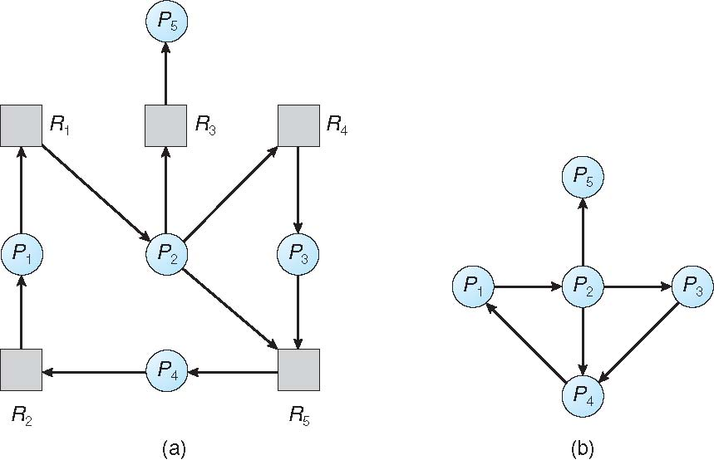
Resource Allocation Graph vs. Wait-for Graph
Resource Allocation Graph Corresponding Wait-for Graph

Slide 30
System with Multiple Instances of a Resource Type
Data structures for deadlock detection
Available: A vector of length m indicates the number of available resources of each type
Allocation: An n x m matrix defines the number of resources of each type currently allocated to each process
Request: An n x m matrix indicates the current request of each process. If Request [i][j] = k, then process P_{i} is requesting k more instances of resource type R_{j}.

Slide 31
Deadlock Detection Algorithm
1. Let Work and Finish be vectors of length m and n, respectively Initialize:
(a) Work = Available
(b) For i = 1,2, …, n, if Request_{i} ≠ 0, then Finish[i] = false; otherwise, Finish[i] = true and Work = Work + Allocation_{i}
2. Find an index i such that both:
(a) Finish[i] == false
(b) Request_{i} ≤ Work
If no such i exists, go to step 4
3. Work = Work + Allocation_{i} Finish[i] = true go to step 2
If Finish[i] == false, for some i, 1 ≤ i ≤ n, then the system is in deadlock state. Moreover, if Finish[i] == false, then P_{i} is deadlocked
Algorithm requires an order of O(mxn²) operations to detect whether the system is in deadlocked state

Slide 32
Example of Deadlock Detection Algorithm
Five processes P₀ through P₄; three resource types A (7 instances), B (2 instances), and C (6 instances)
Snapshot at time T₀:
Allocation Request Available
A B C A B C A B C
P₀ 0 1 0 0 0 0 0 0 0
P₁ 2 0 0 2 0 2
P₂ 3 0 3 0 0 0
P₃ 2 1 1 1 0 0
P₄ 0 0 2 0 0 2
Sequence <P₀, P₂, P₃, P₁, P₄> will result in Finish[i] = true for all i

Slide 33
Example of Deadlock Detection (cont.)
P₂ requests an additional instance of type C
Request
A B C
P₀ 0 0 0
P₁ 2 0 2
P₂ 0 0 1
P₃ 1 0 0
P₄ 0 0 2
State of system?
Can reclaim resources held by process P₀, but insufficient resources to fulfill other processes; requests
Deadlock exists, consisting of processes P₁, P₂, P₃, and P₄

Slide 34
When to Apply Deadlock Detection
When, and how often, to invoke depends on:
How often a deadlock is likely to occur?
How many processes will need to be rolled back?
one for each disjoint cycle
If detection algorithm is invoked arbitrarily, there may be many cycles in the resource graph and so we would not be able to tell which of the many deadlocked processes “caused” the deadlock.

Slide 35
Deadlock Recovery: Process Termination
Abort all deadlocked processes
Abort one process at a time until the deadlock cycle is eliminated
If one at a time, in which order should we choose to abort?
Priority of the process
How long process has computed, and how much longer to completion
Resources the process has used
Resources process needs to complete
How many processes will need to be terminated
Is process interactive or batch?

Slide 36
Deadlock Recovery: Rollback
Selecting a victim – minimize cost
Rollback – return to some safe state where a resource is released
Starvation – the same process may always be picked as victim, can include number of rollback in cost factor

